Slide 1

LLM Engineering
MASTER AI & LARGE LANGUAGE MODELS

Slide 2

WEEK 8
GAME ON
What you can now do
Generate text and code with Frontier Models and Open Source models using APIs and Hugging Face, including tools, assistants and RAG
Follow a 5 step strategy to solve problems, including dataset curation, making a baseline model, and fine-tuning a Frontier model
Confidently carry out the end-to-end process for selecting and training specialized open source models that can outperform the Frontier
An intensive week lies ahead! After today, you'll be able to:
Use Modal, the serverless platform for AI, to run code remotely
Deploy an LLM behind an API in the cloud
Create an Agent that will be incorporated into an Autonomous Agentic AI solution

Slide 3


RECAP: YOUR 8 WEEK JOURNEY TO MASTERY
Week 3
Week 8
Week 3 - Open Source with Hugging Face
The Finale - Agentic AI
Week 4
LLM ENGINEER
Selecting LLMs and Code Generation
Week 2
Frontier Models with APIs, UIs and Multi-modality
Week 7
Week 1
Week 6
Fine-tuning an Open-Source Model
Foundations and the
Chat Completions API
Week 5
Fine-tuning a Frontier Model
RAG and Question Answering - Creating an Expert
YOU WERE HERE

Slide 4

It's all been building up to this
Capstone Project - "The Price Is Right"
We will build an Autonomous Agentic AI framework
Watches for deals being published online
Estimates the price of the product
Sends a push notification when it finds great opportunities
SEVEN Agents will collaborate in our framework
GPT-5 model will identify the deals from an RSS feed
Our frontier-busting fine-tuned model will estimate prices
We'll also use a Frontier Model with a massive RAG db

Slide 5
The Price Is Right
THE ORDER OF PLAY:
Week 6: Data Curation, Evaluation, Frontier Models
Week 7: Fine-tune Open-Source LLM
Week 8: Deployed model, RAG, Agentic Product
Day 1: Deploy our LLM on modal.com Day 2: Frontier Model + RAG Day 3: Scanner Agent & Messenging Agent Day 4: Planning Agent Day 5: Finale

Slide 6
CAPSTONE
3 Alternative Ways to Follow
1
2
3
Focus on intuition Watch lectures and see the results, recreate the final result
Follow along
Use Lite dataset, take shortcuts
Dig deep
Use the full dataset, tweak, make some changes, run the full platform

Slide 7
Three Definitions of Agents
Sam Altman: “AI systems that can do work for you independently”
Early 2025 consensus: (Anthropic, Hugging Face, ..) AI systems where an LLM controls the workflow
Late 2025: An Agent runs Tools in a Loop to achieve a goal

Slide 8








Agent Architecture
Scanner Agent
Identifies promising deals
The UI
The Agent Framework
Planning Agent
In Gradio, naturally
With memory and logging
Coordinates activities
Ensemble Agent
Estimates prices using multiple models
Messaging Agent
Sends push notifications

Slide 9
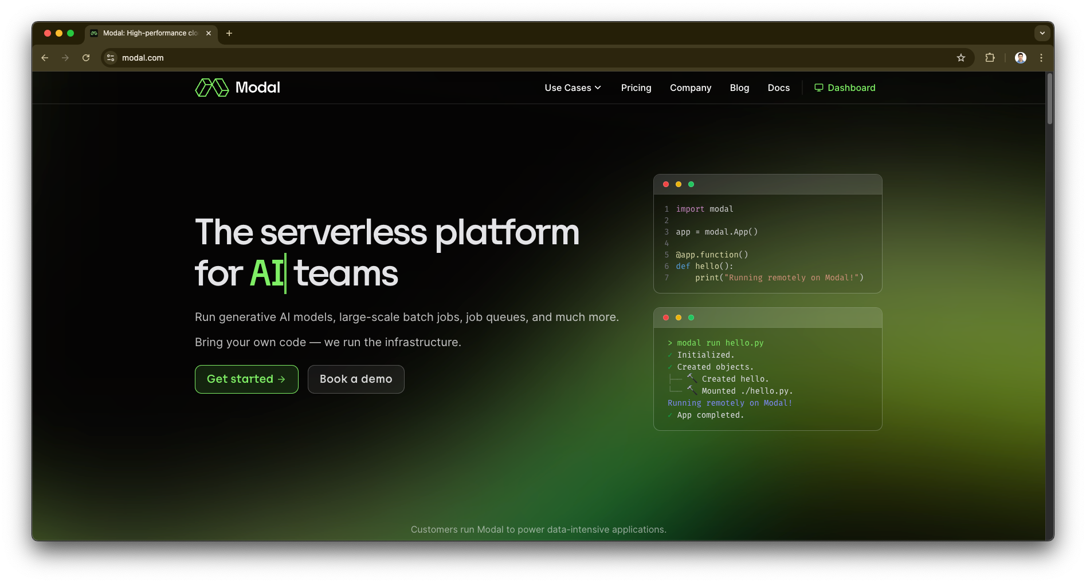
Introducing Modal

Slide 10

WEEK 8
I told you this week would be big!
What you can now do
Generate text and code with Frontier Models and Open Source models using APIs and Hugging Face, including tools, assistants and RAG
Follow a 5 step strategy to solve problems, including dataset curation, making a baseline model, and fine-tuning a Frontier model
Confidently carry out the end-to-end process for selecting and training specialized open source models that can outperform the Frontier
Use Modal to deploy LLMs for production
By end of next time you'll be able to:
Confidently build an advanced RAG solution
Build an ensemble model with a high level of expertise\
Deliver production ready code to call a number of models

